Slide 1
COMP 282: Advanced Data Structures Instructor: Mahdi Ebrahimi Summer 2020 – Session 3

Slide 2
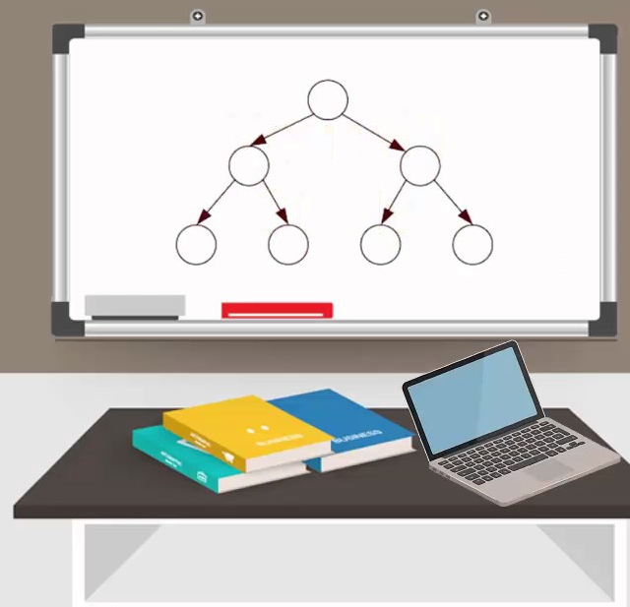
Lecture Plan
Introduction
About the instructor
About the course

Slide 3
About me
August 2019 – present: Assistant Professor at CSUN Computer Science Department
September 2017 – July 2019: Assistant Professor at LTU Math. And Computer Science Department
August 2017: Ph.D. from Wayne State University, Detroit, Michigan, Big Data Research Lab
Dissertation: “Data Placement And Task Mapping Optimization For Big Data Workflows In The Cloud”

Slide 4
Big Data Management: Parallel processing of big data, optimal data partitioning and placement in the Cloud, Cloud-based workflow task mapping, big data workflows scheduling.
Instructor’s research interests

Slide 5
About me
Homepage:
https://mebrahimii.github.io
Email:
mahdi.ebrahimi@csun.edu

Slide 6
About you
Your program: B.S. vs M.S.
Your department: (CS, CE, …)
Your knowledge about (in Java):
Object-oriented Concepts (OO)
Linked List, Stacks and Queues
----------------------------------------------
Trees
Graphs
Hashing Tables
SQL Databases (MS Access, MS SQL Sever, MySQL, …)
Prerequisites
COMP 182/L and
MATH 150A
(Please email me if you have any difficulties to access computers and internet. )

Slide 7
Teaching Style
Share with me your learning experiences about your online classes in the last semester (spring 2020)
What online teaching methodologies do you prefer?
Synchronized
Asynchronized
Combination of both
Is there any time difference between you and the class time? How many hours?

Slide 8
Logistics
Lectures/Labs:
MTuWTh, 01:00 - 02:35 PM, online via Zoom
Office hours:
Instructor: Monday and Wednesday, 11:30-12:30pm, via Zoom (email me to schedule it)
Feel free to email me at any time with minor questions, major questions are for office hours

Slide 9

Zoom Lecture Policy
In the event the course is held online, students will be required to appear on webcam during lectures and exams.
For students who feel this is a violation of their privacy, they can take steps to create a neutral background, either physically or electronically.
For any student who still objects, the instructor may be able to grant exceptions if the student provides the instructor with a reasonable justification for why the policy is not acceptable. Requests for exceptions will be considered on a per student basis.

Slide 10

Course structure
Course contents:
Graphs
Trees
Hash Tables
Intro to relational databases
Workload:
Assignments/Projects
Midterm exams
Final exam
Grading:
Assignments/Projects (~3) – 30%
Midterm exam 1 – 15%
Midterm exam 2 – 15%
Lecture final exam (Comprehensive) – 40%

Slide 11
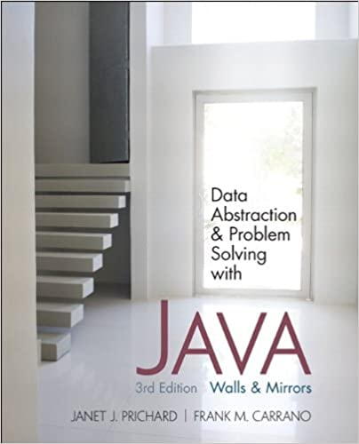
Textbooks
No textbook is required. If you’d like a textbook for further study,
one decent supplemental textbook is:
[1] Data Abstraction and Problem Solving with Java
(any edition)
J. Prichard & F. Carrano
[2] ON-LINE RESOURCES:
Class Canvas
Class announcements, updates to schedule and assignments, useful links, etc.

Slide 12
Goals of COMP 282
Introduction to advanced data structures (particularly persistent structures) using object-oriented design. Main memory structures, hash tables and trees. Architectural foundations for files. Large-scale sorting. Hash-based persistent structures. Indexed files. Introduction to databases.

Slide 13

Exams
Midterms and Final Exam will be online via Canvas
Test overall comprehension and general knowledge

Slide 14
Assignments/Projects
Individual and submit your own work
For assignments (and only assignments), students may discuss among each other, as long as they don’t share actual solutions (this forbids digitally sharing code). That is, you cannot simply copy someone else’s solution.
The only stipulation is that if you do discuss with someone else, say so in your submission.

Slide 15
Late Policy

Slide 16
Schedule
Weeks | Topics | Note
Week 1 – 2 | Class Introduction, Data Structures Review (Linked List, Stack and Queue)
Week 2 – 1 | Introduction to Graphs
Week 2 – 2 | Searching Graphs (BFS and DFS)
Week 3 – 1 | Shortest Path, Trees, and MST
Week 3 – 2 | Binary Trees, Balance, Rotation, and Review | Midterm 1 Project 1 deadline
Week 4 – 1 | Introduction to Specialized Binary Trees
Week 4 – 2 | AVL Trees and B-Trees
Week 5 – 1 | Red Black Trees
Week 5 – 2 | Hashing Functions, Hash Tables, and Collisions | Project 2 deadline
Week 6 – 1 | Files, Data Access, and Review | Midterm 2
Week 6 – 2 | Introduction to Databases and SQL Data Design, Keys, and Normal Forms
Week 7 – 1 | Comprehensive Review | Final Exam Project 3 deadline

Slide 17

Let’s Go!!

